Slide 1

Technological Environment in Management Fundamentals
This presentation explores the ever-evolving technological landscape and its impact on management principles. It will delve into key concepts, trends, and strategies relevant to the modern business environment.
..
by .. ..

Slide 2
The Concept of Technology in Management
What is Technology?
Relevance in Management
Technology refers to the tools, techniques, and knowledge used to create products and services, encompassing hardware, software, processes, and information.
Technology plays a vital role in management by enhancing efficiency, streamlining operations, facilitating communication, and providing insights for better decision-making.

Slide 3
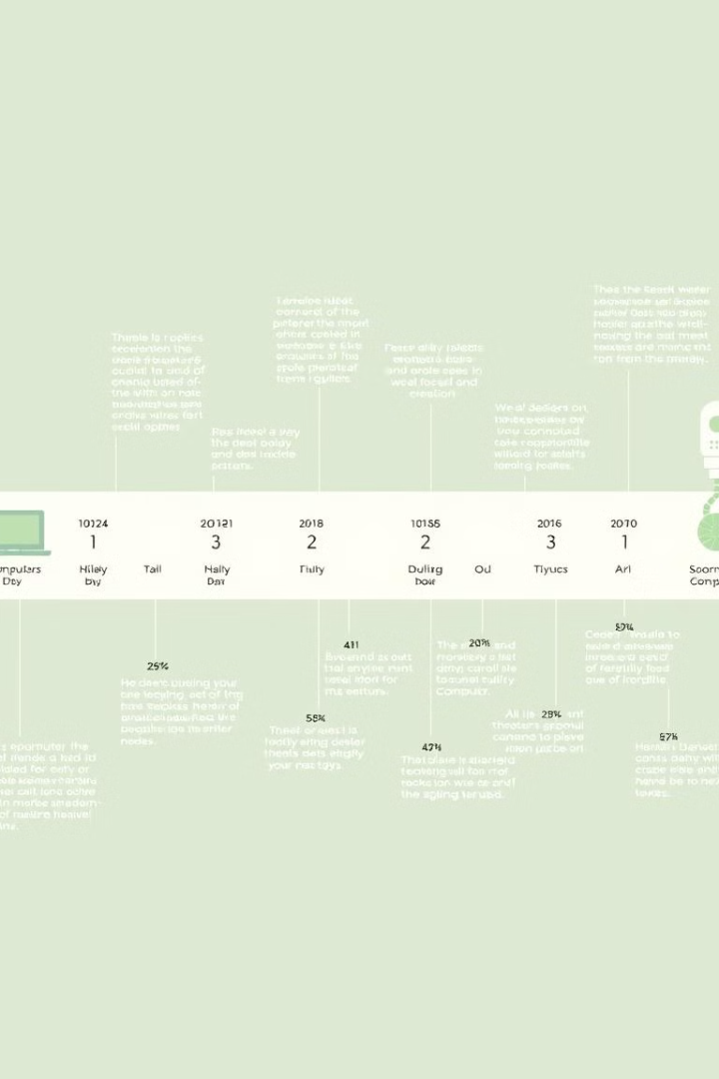
Dynamics of Technological Change
1
Rapid Pace
The pace of technological change is accelerating, leading to constant disruption and innovation in various industries.
2
Digital Transformation
Digital technologies are transforming business models, creating new opportunities and posing new challenges for managers.
3
Adaptability
Managers need to be adaptable and embrace ongoing learning to navigate these dynamic technological changes.

Slide 4

Technological Environment: Definition and Importance
Definition
Impact
The technological environment encompasses all technologies relevant to an organization's operations, including tools, infrastructure, and information systems.
This environment shapes an organization's competitive advantage, efficiency, and ability to adapt to market demands.

Slide 5

Technology Policy in Management
Strategic Alignment
Investment & Adoption
Organizations must develop clear technology policies that align with their overall business goals and strategic priorities.
Technology policies guide investment decisions, technology adoption, and the implementation of new systems.
Ethical Considerations
Policies should address ethical implications of technology use, data privacy, cybersecurity, and responsible innovation.

Slide 6




R&D Scenario in India
Growing R&D Investments
India has seen significant growth in R&D investment, particularly in areas like IT, pharmaceuticals, and renewable energy.
Focus on Innovation
Indian companies are actively engaged in developing innovative technologies and solutions across various sectors.
Collaboration & Partnerships
There is a growing emphasis on collaborations between universities, research institutions, and industry players to foster innovation.

Slide 7



Technology Transfer in Management
Definition
1
Benefits
2
Faster adoption, access to expertise, and competitive advantage.
Challenges
3
IP protection, cultural differences, and implementation difficulties.

Slide 8
Conclusion: Embracing the Technological Landscape
1
Key Takeaways
Adaptability
2
Embrace continuous learning and adaptability to thrive in a rapidly changing technological landscape.
Strategic Planning
3
Develop proactive technology strategies aligned with business goals and priorities.
Innovation
4
Foster a culture of innovation, experiment with new technologies, and embrace emerging trends.

